Slide 1
Retrofit in Android
Week 9-10

Slide 2
Retrofit in Android

Slide 3
Contents
What is an Retrofit?
What is an API Call?

Slide 4
Retrofit in Android

Slide 5
What is an Android Manifest File?
In the world of Android app development, making network requests to fetch data from APIs is a common task.
Retrofit is a powerful and popular library that simplifies this process by providing a clean and efficient way to make API calls.

Slide 6
What is an Android Manifest File?
Retrofit is a type-safe HTTP client for Android and Java developed by Square.

Slide 7
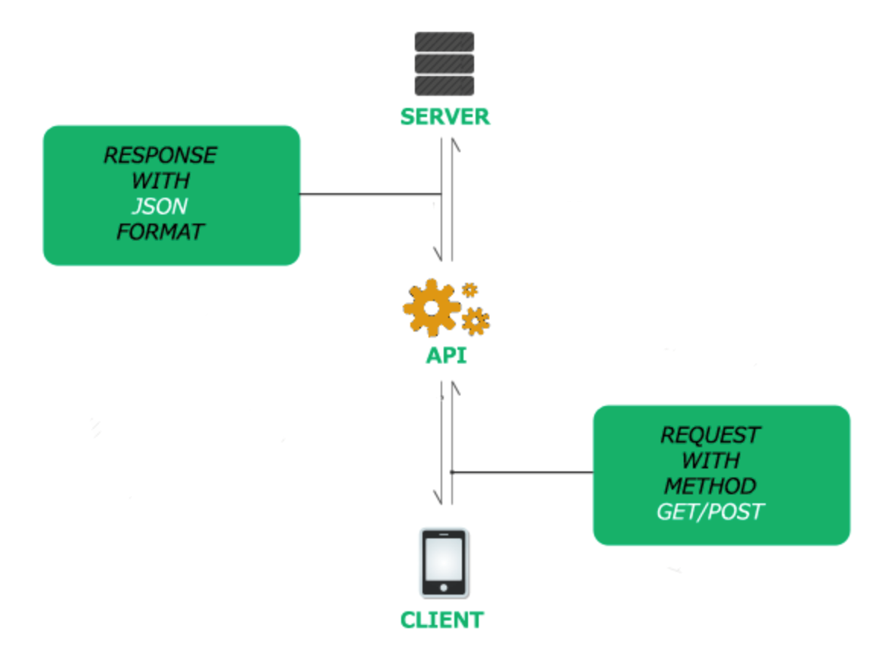
What is an Android Manifest File?

Slide 8
END

